Slide 1




Building Your Personal
B.R.A.N.D. – For Career Transition
B.R.A.N.D. = Beliefs + Representation + Autonomy + Network + Differentiate
“Your B.R.A.N.D. is the bridge between who you’ve been
and where you’re going next."
www.TheNetworkingNavigator.com
Tom Gosche- The Networking Navigator tom@thenetworkingnavigator.com 630-675-8971 www.thenetworkingnavigator.com
1
Notes:
Career transition can make you question how to describe yourself.
Your title may change; your experience and value don’t disappear.
Today is about getting clear on what you bring and what you want next.
Your B.R.A.N.D. becomes the bridge from where you’ve been to where you’re going.

Slide 2
Your B.R.A.N.D. Is Your Career Compass
Career transition changes your title — not your value.
Your personal brand helps people understand what you do well,
what you want next,
and how they can help connect you to the right opportunity.
Be Clear
Be Visible
Be Memorable
Know the strengths and experience you want to carry forward.
Show up where employers, peers, and advocates can see your value.
Give people a simple, consistent way to describe and recommend you.
Tom Gosche- The Networking Navigator tom@thenetworkingnavigator.com 630-675-8971 www.thenetworkingnavigator.com
2
Notes:
Your brand gives people a quick understanding of you.
Be clear: What do you bring?
Be visible: Are the right people seeing you?
Be memorable: Can someone easily describe you to someone else?
The goal is to make it easier for people to help you.

Slide 3
What Does Your Brand Need to Do in Transition?
A clear brand should help someone answer three questions about you:
1. What do you bring?
2. What you want next?
3. How can I help?
Your experience, strengths, knowledge, and the results you know how to create.
The role, environment, challenge, or impact you want to move toward.
The clearer your direction is, the easier it is for someone to make an introduction or share an opportunity.
You don’t need a perfect pitch. You need a clear story.
Tom Gosche- The Networking Navigator tom@thenetworkingnavigator.com 630-675-8971 www.thenetworkingnavigator.com
Notes:
Three simple questions.
What do you bring? Experience, skills, knowledge, results.
What do you want next? Be specific enough to create direction.
How can I help? People need to know what introductions to make.
You don’t need a perfect pitch—you need a clear story.
Now introduce your self in 30 seconds,

Slide 4
The B.R.A.N.D. Framework – Career Transition
B
Beliefs
What values and strengths should guide my next role?
R
Representation
Where and how will people see my value?
A
Autonomy
How will I structure my search and protect my energy?
N
Network
Who can advise, introduce, or advocate for me?
D
Differentiate
What makes me memorable and recommendable?
Tom Gosche- The Networking Navigator tom@thenetworkingnavigator.com 630-675-8971 www.thenetworkingnavigator.com
3
Notes:
B — Beliefs: What drives you?
R — Representation: How and where do you show up?
A — Autonomy: How are you managing your search?
N — Network: Who can help you move forward?
D — Differentiate: Why should someone remember you?
These five pieces work together.

Slide 5
Beliefs-
Clarify What Drives You
Your beliefs shape your direction and your reputation.
What values guide the kind of work or workplace I want next?
Which skills or strengths do I feel most energized using?
What topics, causes, or results make me feel most fulfilled?
Your beliefs form the foundation of your next chapter.
Think: How can you express these beliefs when you describe what you’re looking for?
Tom Gosche- The Networking Navigator tom@thenetworkingnavigator.com 630-675-8971 www.thenetworkingnavigator.com
4
Notes:
Don’t start with job titles—start with what you do well.
What parts of your previous work energized you?
What values do you want in your next workplace?
Think talents, knowledge, skills, characteristics and values.
Your next job doesn’t have to look exactly like your last one.
Prompt a quick reflection. Invite 30 seconds of silent writing or pair-share.
What Talents do you have?
What Knowledge do you have?
What Skills do you have?
What general Characteristics do you have?
What do you Value most?

Slide 6
Representation
Show Up Where You Shine
Where do I naturally build trust (LinkedIn posts, one-on-one coffee chats, written communication)?
What kind of presence do I want to project — calm, confident, creative, reliable?
How can I share insights or stories that reflect the type of work I want next?
In transition, how you show up — online and in person — helps people see your value.
Think: Does your LinkedIn profile and activity reflect the role you want next?
Tom Gosche- The Networking Navigator tom@thenetworkingnavigator.com 630-675-8971 www.thenetworkingnavigator.com
4
Notes:
Your résumé is only one representation of you.
Think LinkedIn, networking, conversations and professional groups.
Where do you naturally build trust?
Make sure how you show up matches where you want to go.
Don’t only say you’re looking—demonstrate what you know.

Slide 7
Autonomy-
Own Your Schedule and Energy
How can I design my week to balance outreach, applications, and personal recharge?
What boundaries help me stay positive and avoid burnout?
When do I feel most energized for networking or interviews?
Job searching can feel reactive. Structure gives your transition purpose and rhythm.
Think: Treat your transition like your next job — with priorities, a schedule, and measurable actions.
Tom Gosche- The Networking Navigator tom@thenetworkingnavigator.com 630-675-8971 www.thenetworkingnavigator.com
4
Notes:
A job search can easily become reactive.
Treat the transition like a job.
Schedule applications, networking, follow-up and learning.
Build in time to recharge.
Consistency is more sustainable than trying to do everything every day.

Slide 8
Autonomy-
Make Intentional Decisions
Career Transition Strategy Matrix
Does this move me toward my target role?
Does it use or strengthen the skills I want to be known for?
Is this the best use of my time and energy?
Does it represent the B.R.A.N.D. I want people to remember?
Tom Gosche- The Networking Navigator tom@thenetworkingnavigator.com 630-675-8971 www.thenetworkingnavigator.com
4
Notes:
Not every networking event or opportunity deserves your time.
Ask: Does this move me toward my target?
Does it strengthen the skills or reputation I want?
Is this the best use of my time and energy?
Be intentional instead of simply staying busy.

Slide 9
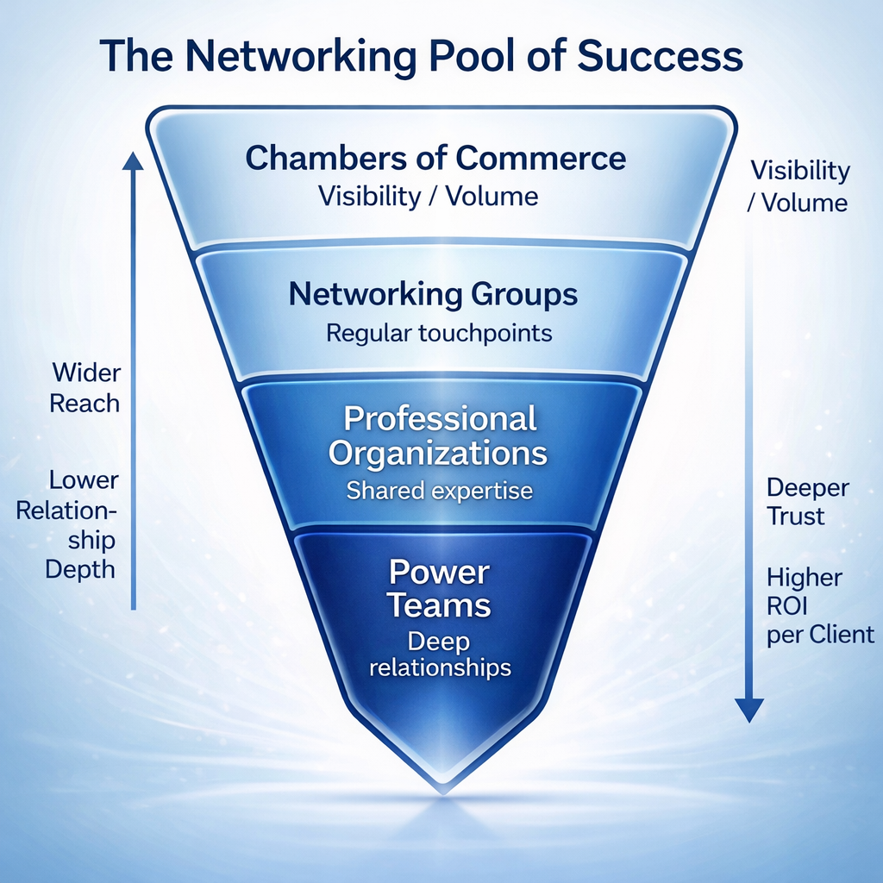
4
Notes:
I normally teach this concept to business owners—it works for career transition too.
At the top: broader visibility and more people.
As you move down: fewer people, but stronger relationships.
Events create exposure; professional groups create repeated contact.
Former colleagues and company connections can get closer to opportunities.
Mentors, advocates and Power Partners have the trust to actively help.

Slide 10
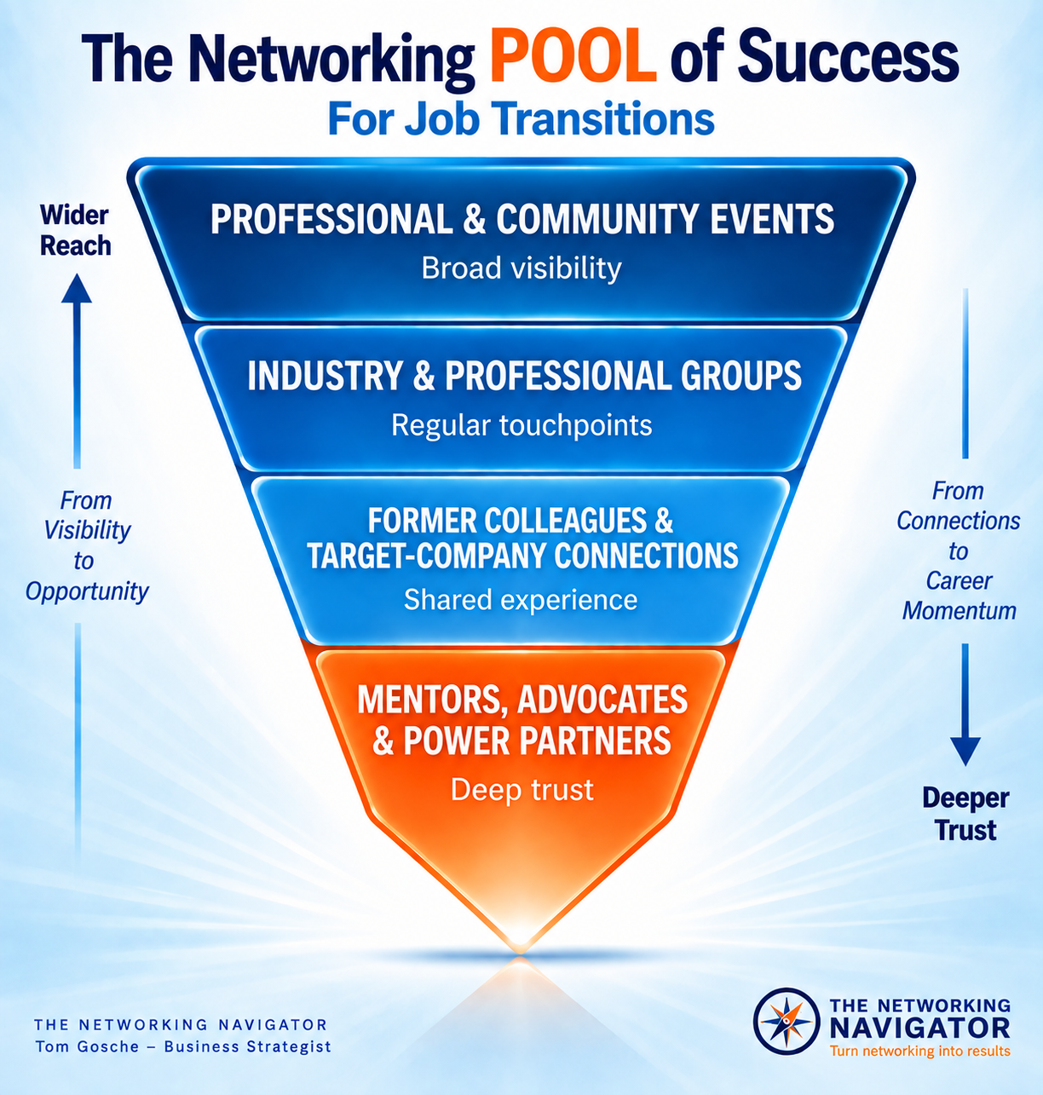
4
Notes:
I normally teach this concept to business owners—it works for career transition too.
At the top: broader visibility and more people.
As you move down: fewer people, but stronger relationships.
Events create exposure; professional groups create repeated contact.
Former colleagues and company connections can get closer to opportunities.
Mentors, advocates and Power Partners have the trust to actively help.

Slide 11
PROFESSIONAL & COMMUNITY EVENTS
Job Fairs | Career Events | Local Organizations | Volunteer Opportunities
INDUSTRY & PROFESSIONAL GROUPS
Industry Associations | Online Communities | LinkedIn Groups | Professional Development
FORMER COLLEAGUES & TARGET-COMPANY CONNECTIONS
Past Coworkers | Clients | Vendors | Alumni | Company Connections
MENTORS, ADVOCATES & POWER PARTNERS
Career Advisors | Coaches | Former Managers | Trusted Peers
Tom Gosche- The Networking Navigator tom@thenetworkingnavigator.com 630-675-8971 www.thenetworkingnavigator.com
4
Notes:
Start with people you already know:
PROFESSIONAL & COMMUNITY EVENTS
Job Fairs | Career Events | Local Organizations | Volunteer Opportunities
INDUSTRY & PROFESSIONAL GROUPS
Industry Associations | Online Communities | LinkedIn Groups | Professional Development
FORMER COLLEAGUES & TARGET-COMPANY CONNECTIONS
Past Coworkers | Clients | Vendors | Alumni | Company Connections
MENTORS, ADVOCATES & POWER PARTNERS
Career Advisors | Coaches | Former Managers | Trusted Peers

Slide 12
Network-
Activate Meaningful Relationships
Who are five people I trust to give insight, feedback, or introductions?
How can I reconnect with someone who might open a door?
Connections are one of your strongest career assets.
Focus on depth, not just volume.
Think: Make your brand visible through genuine conversations, not just requests.
Tom Gosche- The Networking Navigator tom@thenetworkingnavigator.com 630-675-8971 www.thenetworkingnavigator.com
4
Notes:
Who are five people who understand your work?
Who can give feedback, insight or an introduction?
Reconnect before immediately asking for something.

Slide 13
Network-
Activate Meaningful Relationships
What can I share (ideas, encouragement, introductions) that adds value?
How can I update my LinkedIn profile or activity so it reflects my goals and sparks helpful conversations?
Connections are one of your strongest career assets.
Focus on depth, not just volume.
Think: Make your brand visible through genuine conversations, not just requests.
Tom Gosche- The Networking Navigator tom@thenetworkingnavigator.com 630-675-8971 www.thenetworkingnavigator.com
4
Notes:
Networking during a job search shouldn’t be one-way.
Ask what you can share or contribute.
Make introductions for other people.
Share information or resources.
Staying helpful keeps relationships active.
You are still valuable while you are in transition.

Slide 14
LinkedIn Is Part of Your Network
Your profile should make it easy for someone to understand where you are headed.
Profile
Activity
Connections
Does your headline and About section reflect the work you want next — not only the job you had last?
Comment, share insights, and stay visible with people in your target field.
Reconnect with former colleagues and build relationships with people in target companies and industries.
LinkedIn works best when it supports real relationships.
Tom Gosche- The Networking Navigator tom@thenetworkingnavigator.com 630-675-8971 www.thenetworkingnavigator.com
4
Notes:
LinkedIn should support your networking—not replace it.
Does your profile describe where you’re going or only where you’ve been?
Stay visible through thoughtful comments and posts.
Reconnect with former colleagues.
Connect strategically with people in target companies and industries.
Move important LinkedIn relationships into real conversations.

Slide 15
Your Networking Energy Plan
Choose 2–3 sustainable actions each month.
Visibility
Relationships
Recharge & Growth
Update LinkedIn.
Post or comment regularly.
Attend one targeted event.
Share your expertise.
Schedule coffees.
Reconnect with former colleagues.
Ask for feedback.
Make introductions.
Protect thinking time.
Learn a relevant skill.
Volunteer strategically.
Celebrate progress.
Consistency beats intensity. Build a rhythm you can maintain.
Tom Gosche- The Networking Navigator tom@thenetworkingnavigator.com 630-675-8971 www.thenetworkingnavigator.com
4
Notes:
Don’t try to do everything.
Pick 2–3 actions you can repeat consistently.
Visibility: Be seen.
Relationships: Have actual conversations.
Recharge & Growth: Protect your energy and keep developing.
Consistency beats intensity.

Slide 16
Differentiate-
Define What Makes You Memorable
What do people say about me when I’m not in the room?
What feedback have I heard most often about my approach?
What impression do I want to leave after every conversation or interview?
Your differentiation is your unique mix of strengths, experience, style, and results.
Think: What is the one sentence you want people to remember — and repeat — about you?
Tom Gosche- The Networking Navigator tom@thenetworkingnavigator.com 630-675-8971 www.thenetworkingnavigator.com
4
Notes:
Your experience alone doesn’t differentiate you.
What do people consistently thank you for?
What feedback have you heard throughout your career?
What do you do differently or particularly well?
Think: What do people say about you when you’re not in the room?
Give them something worth repeating.

Slide 17
Brand Statement
Connect your past experience to your future direction.
“I’m looking for a role where I can use my [top strengths/skills]
to [create this impact/result] for [this type of team, company, or industry].”
Technology
Finance
“I’m looking for a role where I can use my technical expertise and collaborative approach to design solutions that make systems more efficient and user-friendly.”
“I use financial data to tell the story behind the numbers — helping leaders make informed decisions that drive profitability and growth.”
Tom Gosche- The Networking Navigator tom@thenetworkingnavigator.com 630-675-8971 www.thenetworkingnavigator.com
4
Notes:
This answers the networking question: “What are you looking to do next?”
Don’t recite your résumé.
Connect what you’ve done with where you want to go.
Strengths + impact + type of organization/role.
Keep it conversational.
The listener should immediately understand how they might help.

Slide 18
Brand Statement
More Examples
Management / Leadership
Operations / Project Management
Consulting / Client-Facing
“I’m looking for a management role where I can empower people to perform at their best through clear communication and consistent follow-through.”
“I bring calm, clarity, and organization to complex projects — helping cross-functional teams stay focused, on time, and on target.”
“I’m seeking a role where I can combine strategic thinking with relationship-building to help clients solve challenges and achieve lasting success.”
The goal is not to sound rehearsed. The goal is to make your direction easy to understand.
Tom Gosche- The Networking Navigator tom@thenetworkingnavigator.com 630-675-8971 www.thenetworkingnavigator.com
4
Notes:
There isn’t one perfect formula for every profession.
Notice that each example focuses on value—not just a job title.
Management: people and performance.
Operations: organization and results.
Consulting: relationships and problem-solving.
Build yours around the impact you want to make.

Slide 19

Your Next Opportunity Begins with Clarity
Own your story. Share it clearly.
Make it easy for people to understand where you are going next.
1. Build Your B.R.A.N.D.
2. Write Your Statement
3. Work Your Plan
Clarify Beliefs, Representation, Autonomy, Network, and Differentiation.
Be ready when someone asks, “What are you looking to do next?”
Choose Visibility, Relationship, and Recharge actions each month.
Tom Gosche- The Networking Navigator tom@thenetworkingnavigator.com 630-675-8971 www.thenetworkingnavigator.com
10
Notes:
Bring the five parts of your B.R.A.N.D. together.
First: know what you bring and what you want.
Second: be ready to communicate it.
Third: work your networking plan consistently.
Make it easy for other people to understand—and help—you.
Clarity creates confidence, and confidence creates momentum.
Don’t try to finish all of this today.
Use the worksheet to work through each part of your B.R.A.N.D.
Write and practice your Brand Statement.
Identify your first three networking actions.
Revisit it as your search evolves.
Your B.R.A.N.D. should develop as you get clearer about what comes next.

Slide 20

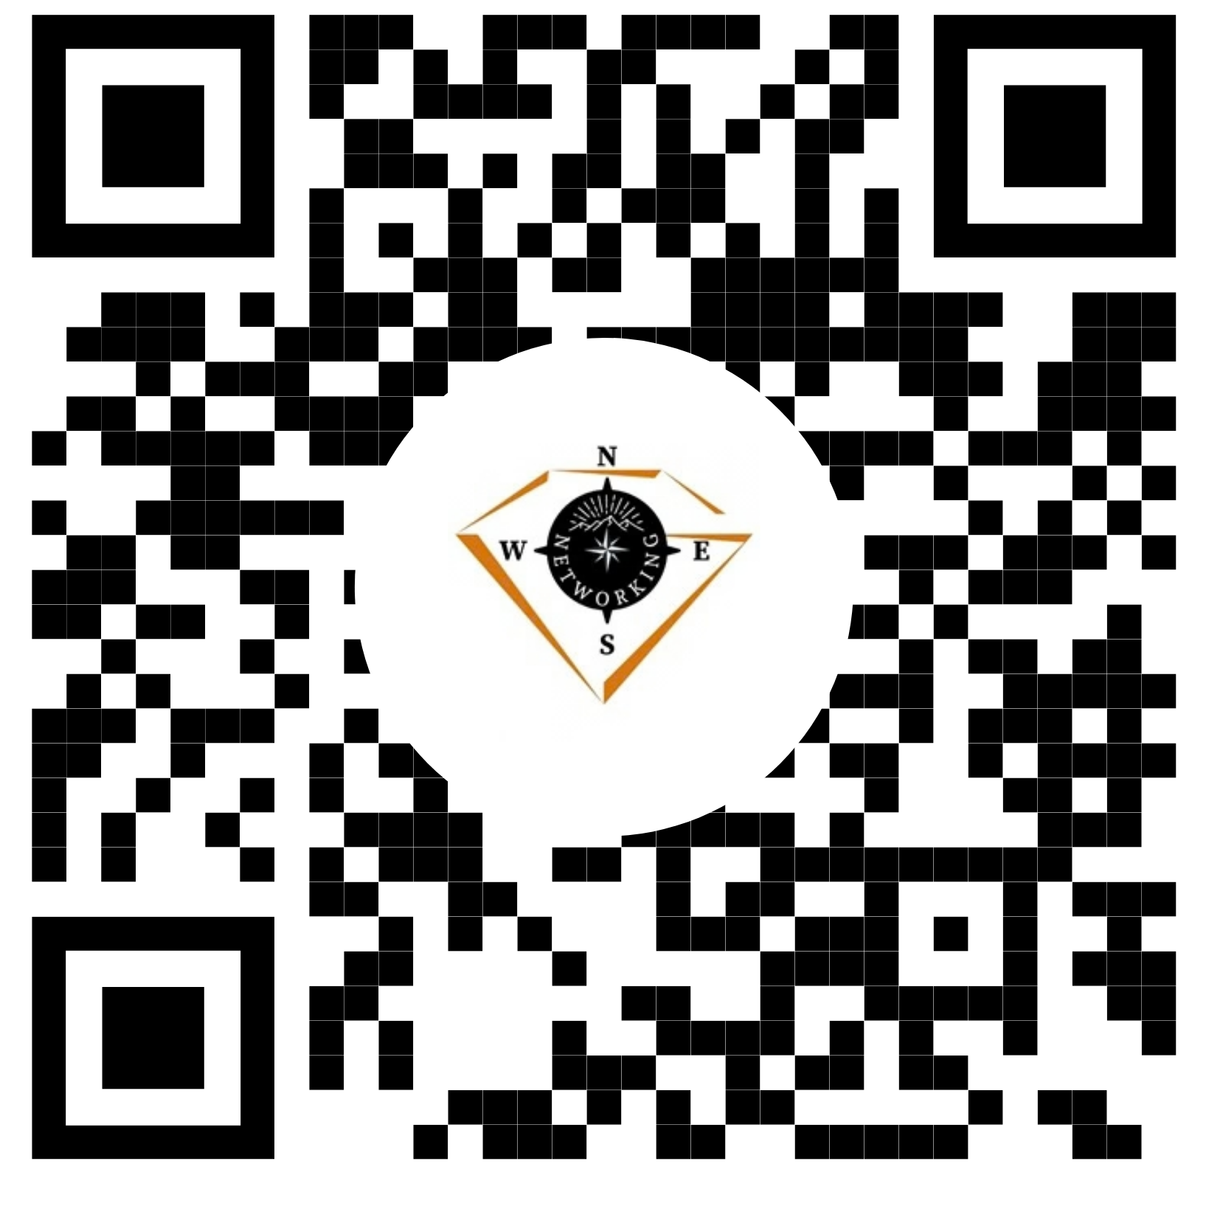
Get the Career Transition Playbook & Worksheet FREE
When you align your brand with your strengths,
your BRAND attracts opportunities.
Get the Playbook and
Success Track
Get the Career Transition Playbook & Worksheet • TheNetworkingNavigator.com
10
Notes:
The Networking Navigator is an on-demand system designed to help business professionals grow through smarter, more strategic networking.
Inside, you'll find focused Success Tracks that tackle real-world challenges—like perfecting your pitch, building a referral team, and following up after events.
Each one breaks down into Action Steps with practical tools you can use right away. Log in anytime to access worksheets, short videos, and strategies that help you measure what’s working and build real momentum.”
It’s online, it’s practical, and it’s built for people who want to be intentional with their business networking.
Visit thenetworkingnavigator.com and use code TOM5OFF to get started with $5 off your first month.”

